Slide 1
The Heart of the Matter…
From Action to Grace
The Rev’d Jim Quigley
St. Alban’s Episcopal Church
March 11, 2018

Slide 2
The lord’s prayer
Matthew 6:9-13 (NRSV)
Our Father in heaven, hallowed be your name.
Your kingdom come. Your will be done, on earth as it is in heaven. Give us this day our daily bread.
And forgive us our debts, as we also have forgiven our debtors. And do not bring us to the time of trial, but rescue us from the evil one.
Luke 11:2-4 (NRSV)
Father, hallowed be your name.
Your kingdom come.
Give us each day our daily bread.
And forgive us our sins,
for we ourselves forgive
everyone indebted to us.
And do not bring us to the time
of trial.

Slide 3
Aramaic alphabet

Slide 4
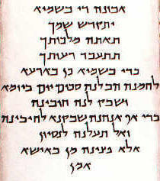
The lord’s prayer Matthew 6 in Aramaic

